Slide 1
Getting started for simple linear regression
Download Regression_worksheet.Rmd from Blackboard. Make sure you have the following new packages installed
performance
corrplot
This package may present an error message without some additional packages installed, e.g. ‘see’. The solution is to install these packages.
If you use the function install.packages(“see”) you will need to delete or comment out this command prior to knitting
knit to Word
Start to read through the worksheet.

Slide 2
Simple linear regression
Statistical Inference

Slide 3
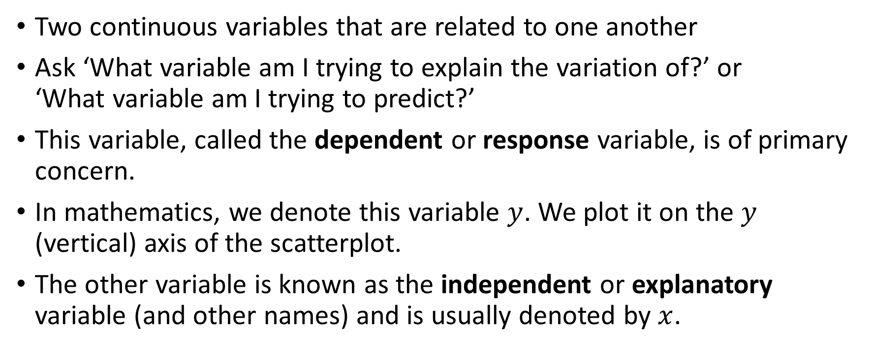
Simple linear regression
Two continuous variables that are related to one another
Ask ‘What variable am I trying to explain the variation of?’ or ‘What variable am I trying to predict?’
This variable, called the dependent or response variable, is of primary concern.
In mathematics, we denote this variable $y$. We plot it on the $y$ (vertical) axis of the scatterplot.
The other variable is known as the independent or explanatory variable (and other names) and is usually denoted by $x$.

Slide 4
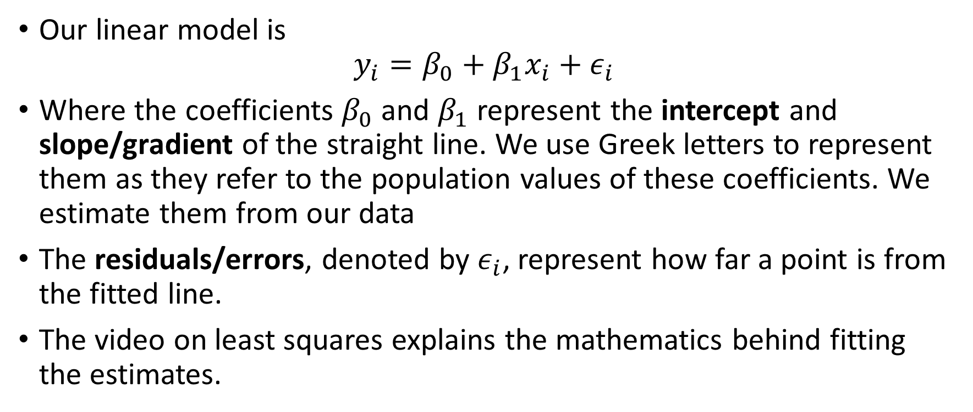
Linear model
Our linear model is $y_{i}=β_{0}+β_{1}x_{i}+ε_{i}$
Where the coefficients $β_{0}$ and $β_{1}$ represent the intercept and slope/gradient of the straight line. We use Greek letters to represent them as they refer to the population values of these coefficients. We estimate them from our data
The residuals/errors, denoted by $ε_{i}$, represent how far a point is from the fitted line.
The video on least squares explains the mathematics behind fitting the estimates.

Slide 5
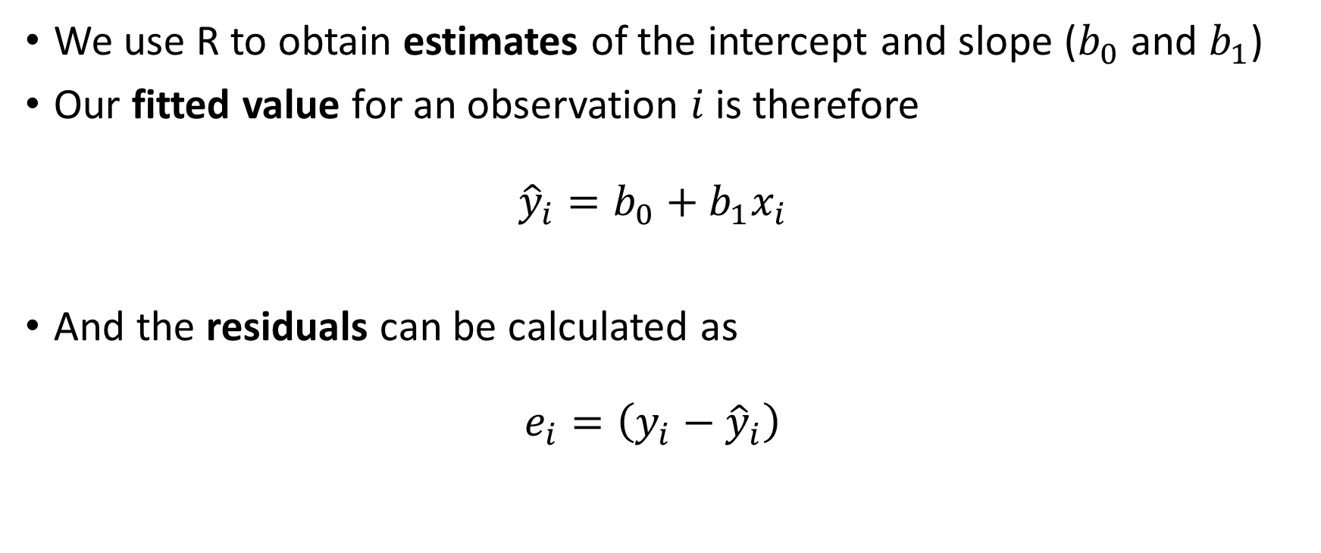
Fitted values
We use R to obtain estimates of the intercept and slope ($b_{0}$ and $b_{1}$)
Our fitted value for an observation $i$ is therefore ${\hat{y}}_{i}=b_{0}+b_{1}x_{i}$
And the residuals can be calculated as $e_{i}=\left(y_{i}−{\hat{y}}_{i}\right)$

Slide 6
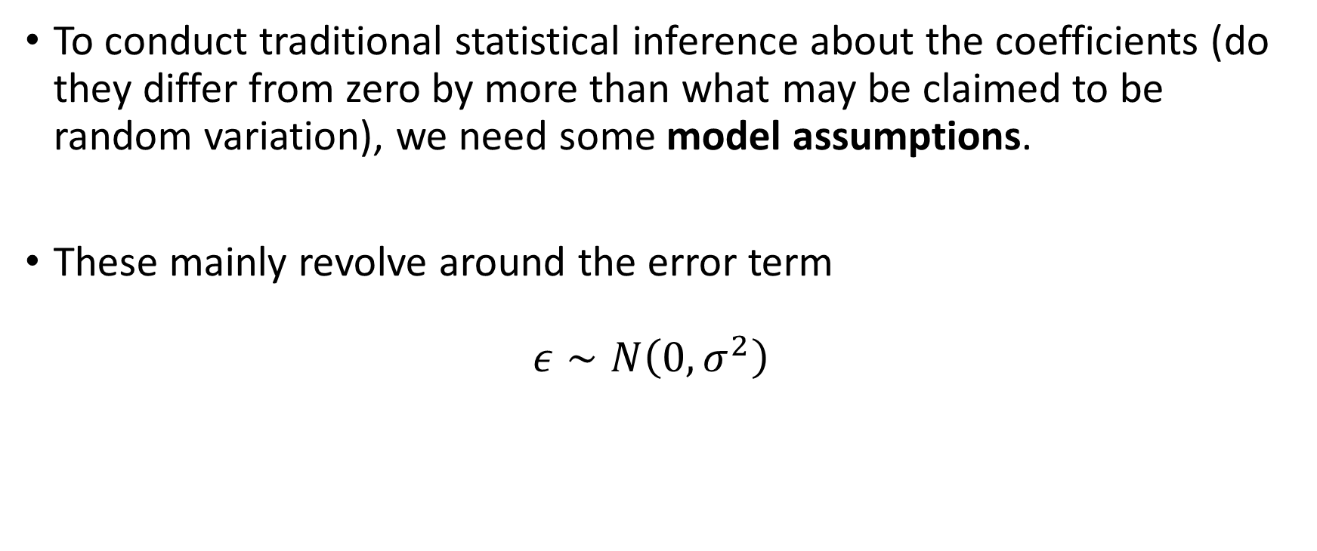
Statistical inference
To conduct traditional statistical inference about the coefficients (do they differ from zero by more than what may be claimed to be random variation), we need some model assumptions.
These mainly revolve around the error term $ε∼N\left(0, σ^{2}\right)$

Slide 7
Model assumptions
The residuals are
normally distributed,
with a mean of zero,
and a constant variance.
All observations are independent of each other.

Slide 8
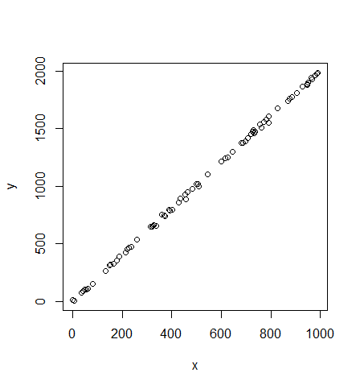
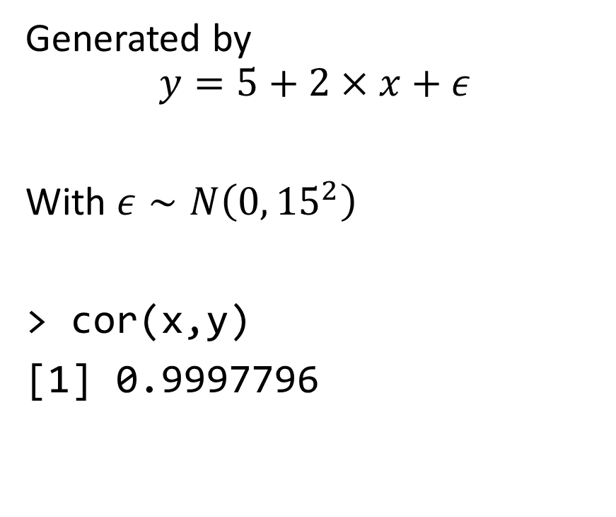
Fake data example – perfectly behaved
Generated by
$$y=5+2×x+ε$$
With $ε∼N\left(0, {15}^{2}\right)$
> cor(x,y)
[1] 0.9997796

Slide 9
Results
Call: lm(formula = y ~ x)
Residuals: Min 1Q Median 3Q Max -38.250 -7.405 0.549 9.628 25.101
Coefficients: Estimate Std. Error t value Pr(>|t|) (Intercept) 5.715055 2.909252 1.964 0.0533 . x 2.000785 0.004917 406.926 <2e-16 *** --- Signif. codes: 0 ‘***’ 0.001 ‘**’ 0.01 ‘*’ 0.05 ‘.’ 0.1 ‘ ’ 1
Residual standard error: 12.65 on 73 degrees of freedom Multiple R-squared: 0.9996, Adjusted R-squared: 0.9996 F-statistic: 1.656e+05 on 1 and 73 DF, p-value: < 2.2e-16

Slide 10
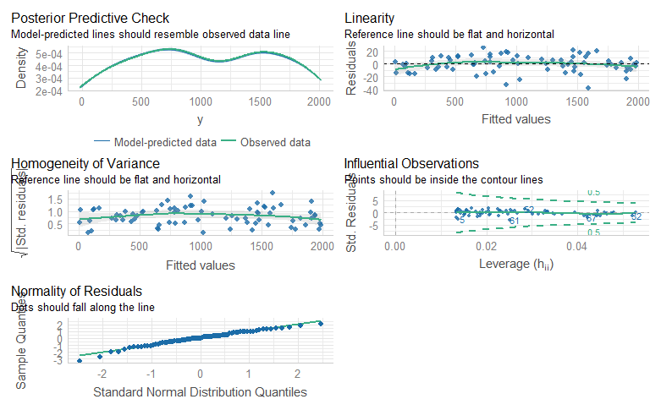
Check model assumptions/performance

Slide 11
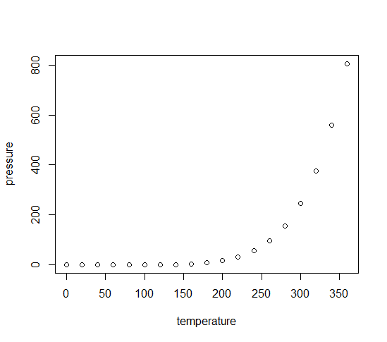
Another example
Vapour pressure of mercury
as a function of temperature
(from the ‘pressure’ data
that is inbuilt in R)
with(pressure, cor(temperature, pressure))
[1] 0.7577923

Slide 12
Results
Call:
lm(formula = pressure ~ temperature, data = pressure)
Residuals:
Min 1Q Median 3Q Max
-158.08 -117.06 -32.84 72.30 409.43
Coefficients:
Estimate Std. Error t value Pr(>|t|)
(Intercept) -147.8989 66.5529 -2.222 0.040124 *
temperature 1.5124 0.3158 4.788 0.000171 ***
---
Signif. codes: 0 ‘***’ 0.001 ‘**’ 0.01 ‘*’ 0.05 ‘.’ 0.1 ‘ ’ 1
Residual standard error: 150.8 on 17 degrees of freedom
Multiple R-squared: 0.5742, Adjusted R-squared: 0.5492
F-statistic: 22.93 on 1 and 17 DF, p-value: 0.000171

Slide 13
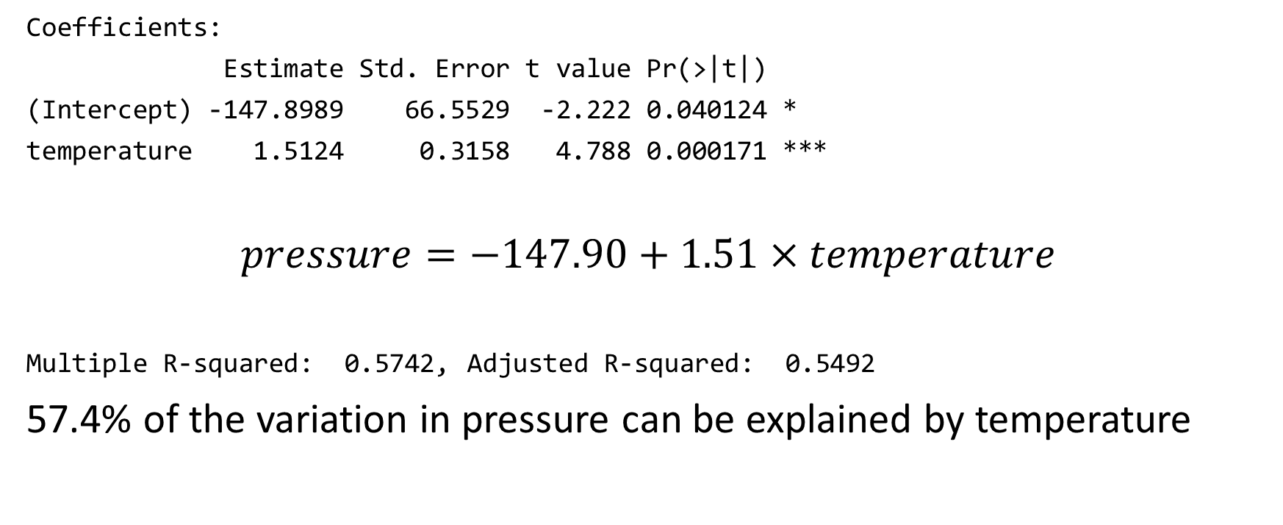
Untangling the results
Coefficients:
Estimate Std. Error t value Pr(>|t|)
(Intercept) -147.8989 66.5529 -2.222 0.040124 *
temperature 1.5124 0.3158 4.788 0.000171 ***
$$pressure=−147.90+1.51×temperature$$
Multiple R-squared: 0.5742, Adjusted R-squared: 0.5492
57.4% of the variation in pressure can be explained by temperature

Slide 14
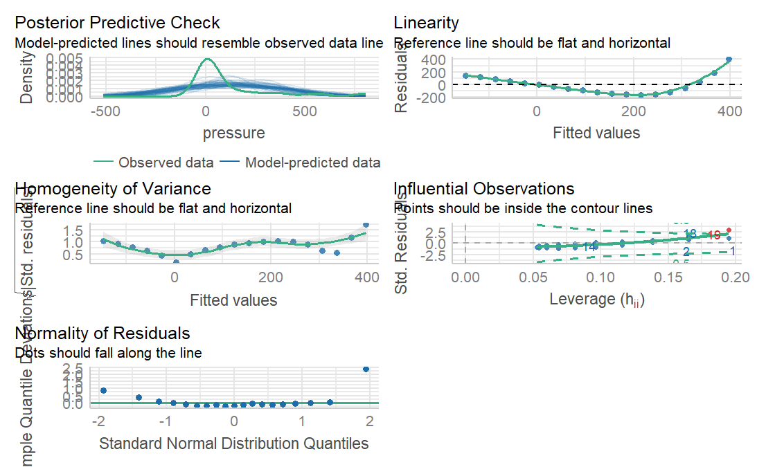
Check model assumptions/performance

